Slide 1
Cloud Computing with Azure
Ajay Choudhary

Slide 2
Agenda
Cloud Computing
Compute Services
Storage Services
Networking Services

Slide 3
Cloud Computing
is the on-demand availability of computer system resources, especially data storage & computing power, without direct active management by the user.

Slide 4


Introduction
Large clouds often have functions distributed over multiple locations, each of which is a data center. Cloud computing relies on sharing of resources to achieve coherence and typically uses a "pay as you go" model, which can help in reducing capital expenses but may also lead to unexpected operating expenses for users. (as per Wikipedia)

Slide 5
Benefits of cloud computing
Cost - Cloud computing eliminates the capital expense of buying hardware and software and setting up and running on-site datacenters
1
Speed - Most cloud computing services are provided self service and on demand, so even vast amounts of computing resources can be provisioned in minutes
2
Scalability - cloud computing services include the ability to scale elastically
3
No Maintenance - On-site datacenters typically require a lot of “racking and stacking”—hardware setup, software patching, and other time-consuming IT management chores.
4
Security - offers a broad set of policies, technologies, and controls that strengthen your security posture overall.
5

Slide 6
Types of cloud computing
Public cloud are owned and operated by a third-party cloud service providers, which deliver their computing resources, like servers and storage, over the Internet.
Private cloud refers to cloud computing resources used exclusively by a single business or organization. A private cloud can be physically located on the company’s on-site datacenter.
Hybrid cloud combine public and private clouds, bound together by technology that allows data and applications to be shared between them.

Slide 7
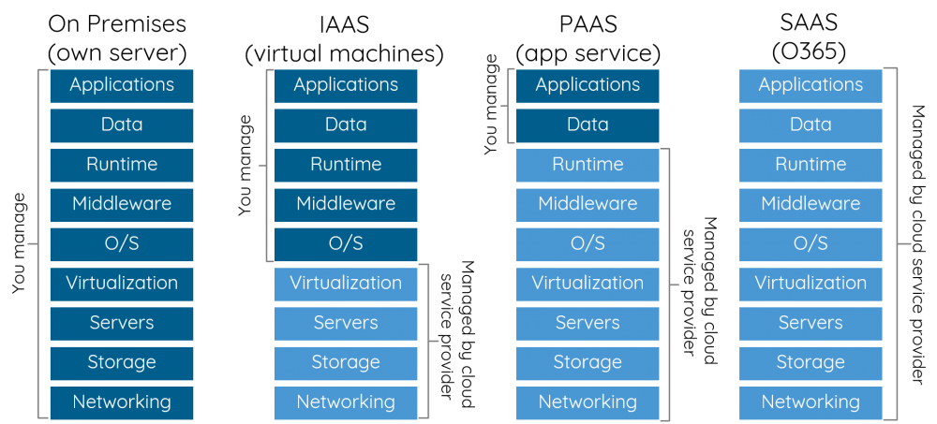
Types of cloud services

Slide 8
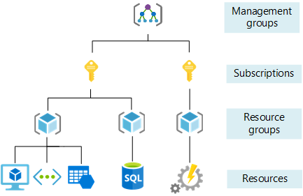
Introduction to Azure

Slide 9
Demo to Azure Portal

Slide 10


Usefull Links
Azure Portal - https://portal.azure.com/
Microsoft Training Courses - https://learn.microsoft.com/en-us/training/
Technical documentation - https://learn.microsoft.com/en-us/docs/

Slide 11
Thank you
Ajay Choudhary
ajay.choudhary@zensar.com
Microsoft Certification's Completed

